Slide 1
T24 Directory Structure, File Classification And Core Parameter Files
Notes:
© 2006 Capgemini - All rights reserved
0

Slide 2
Objectives
At the end of the session you will have
Adequate knowledge to understand
T24 directory structure
File types in T24
File classification in T24
Core parameter files in T24
Notes:
Trainee notes

Slide 3
T24 Directory Structure
bnk
bnk.data
bnk.dict
bnk.run
bnk.help
bnk..jnl
bnk.backup
ac
fx
eb
globusbin
globuslib
bin
lib
bnk is the parent directory
bnk.data : Holds all the data files of T24. Contains subdirectories. Each of the subdirectories refer to the various products installed. Data files of applications are stored under the appropriate subdirectories

Slide 4
T24 Directory Structure
bnk.dict : Holds all the dictionary files of all applications in T24
bnk.run : Home directory for all t24 users. Contains globusbin, globuslib which store the business logic of T24. Bin and lib are used to store any local dev business logic
bnk.help : Directory where help files are installed
bnk.jnl : Holds the F.JOURNAL file which is an application level log file that captures all data input in T24. Only the last 20 transactions data are stored in this file. Journaling is achieved by using jBASE Transaction Journaling if j4 is the database.
bnk.backup : If desired, backup of T24 can be stored here.

Slide 5
Task
List the VOC entry for the FBNK.CUSTOMER file. Check if the data file and the dict file are available in the path specified.

Slide 6
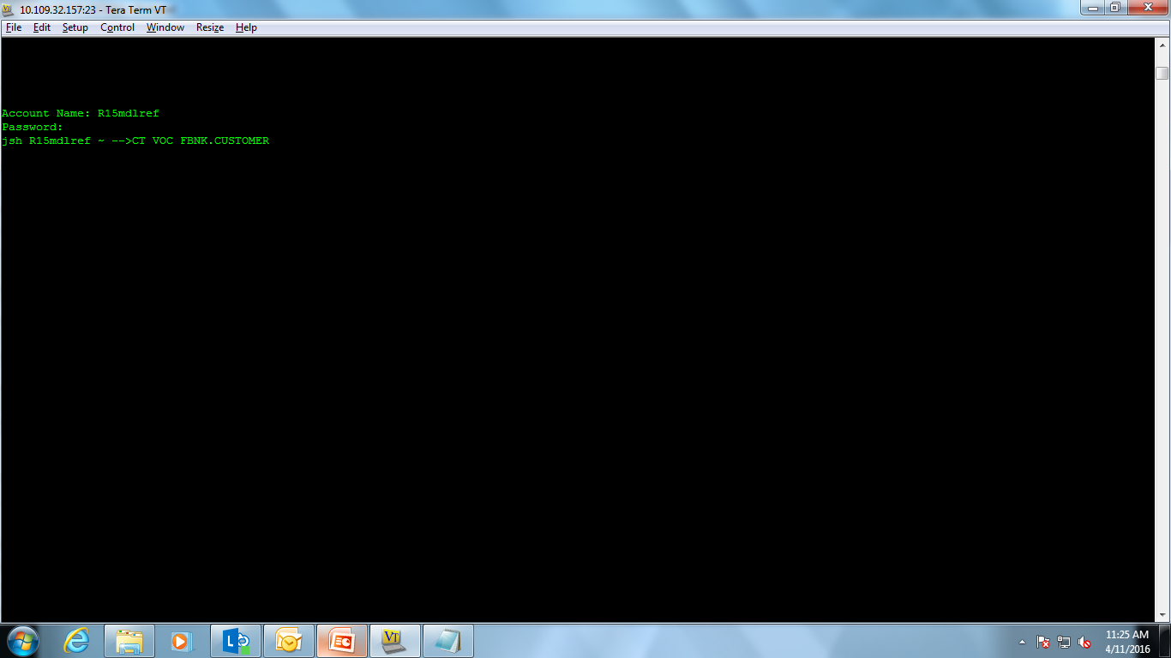
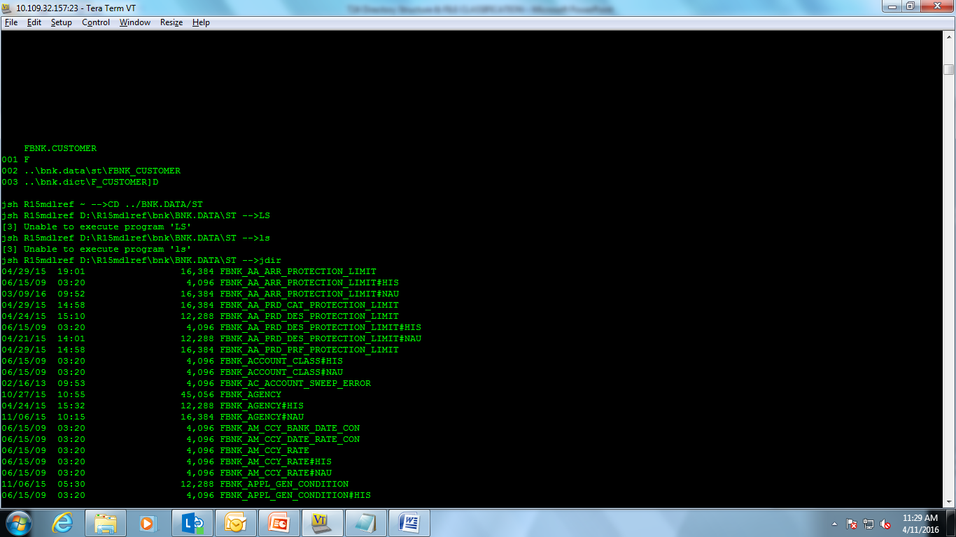
Solution
Login to jBASE
From the jBASE prompt type
The output will display the path of the data and dict file of FBNK.CUSTOMER
Go to the directory using the cd (Change Directory) command.
Eg: cd ../bnk.data/st
Notes:
We will learn about jBASE, jBASE prompt and Classic Navigation in depth in the forth coming sessions.
CT – It’s a jBASE command used to print content of a record.
Syntax: CT <file name> <record id>
Eg: CT VOC FBNK.CUSTOMER

Slide 7
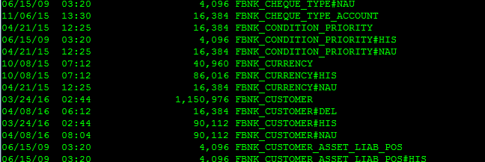
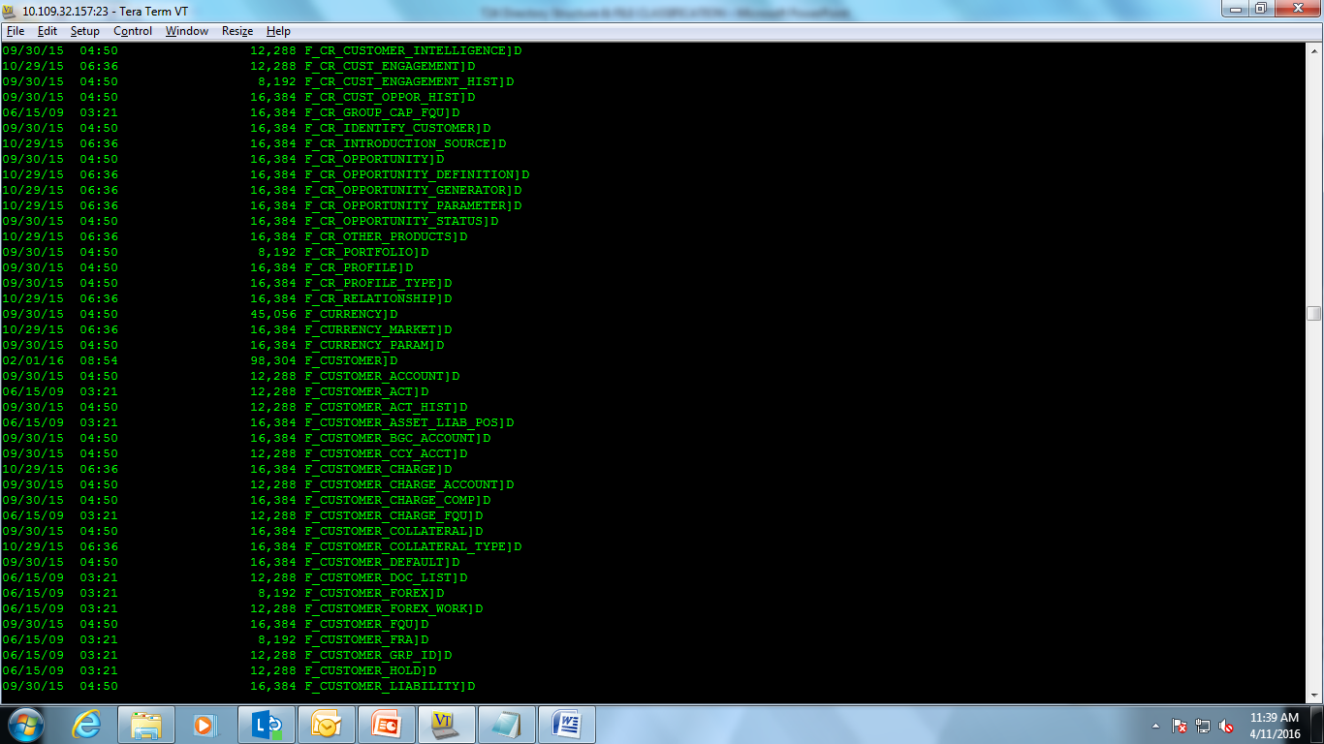
Solution (Contd.)
Now list the contents of the directory using “ls” or “jdir” depending upon the operating system on which jBASE has been installed.
Check if the file exists.
The same steps has to be followed to check if the dict file exists.
Notes:
ls – Lists the contents of a directory file (UNIX)
jdir – Lists the contents of a directory file for jBASE (Windows)

Slide 8
File Types
User inputs and commits a record in the CUSTOMER application
File that gets updated : FBNK.CUSTOMER$NAU
User authorizes the record in the CUSTOMER application
Files that get updated
Record deleted from FBNK.CUSTOMER$NAU
Record written to FBNK.CUSTOMER

Slide 9
File Types
User amends the authorized CUSTOMER record (Record becomes unauthorized again)
Files that get updated
Record written to FBNK.CUSTOMER$NAU (Amended record)
The authorized record remains in the FBNK.CUSTOMER file
User authorizes the amended CUSTOMER record
Files that get updated
Record deleted from FBNK.CUSTOMER$NAU
Amended record written to FBNK.CUSTOMER
Previously authorized record moved to FBNK.CUSTOMER$HIS

Slide 10
File Types (Cont.)
Valid file types
Live file – Holds only authorized records
Unauthorized file ($NAU)
INAU,INAO,INA2,RNAU,RNA2, RNAO,IHLD
History file ($HIS) – Holds copies of authorized records
ID format : <Record ID>;<Sequence Number>
Most of the applications support all the 3 types of files

Slide 11
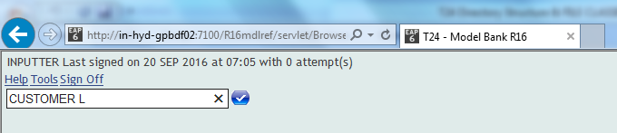
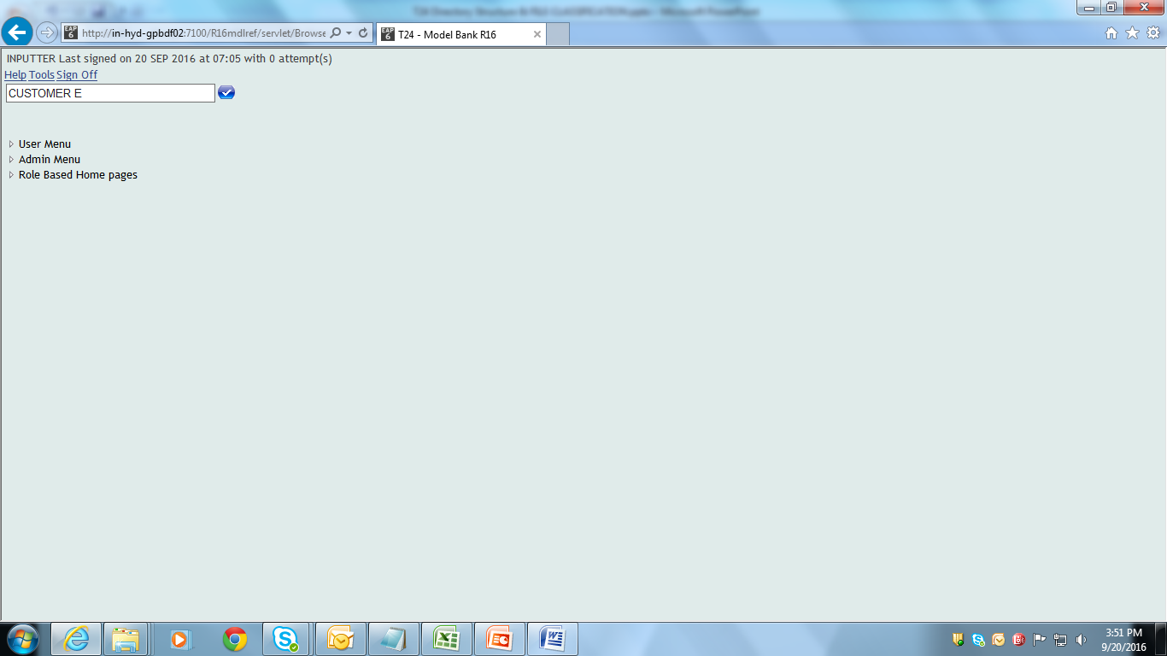
File Types
List authorized CUSTOMER records
List unauthorized CUSTOMER records
Notes:
The alternate way to list the CUSTOMER(or any application) records is to do a listing from the jBASE prompt as follows:
To list LIVE Customer records
jsh r8 ~ -->LIST FBNK.CUSTOMER
To list Unauthorized Customer records
jsh r8 ~ -->LIST FBNK.CUSTOMER$NAU
To list Customer History records
jsh r8 ~ -->LIST FBNK.CUSTOMER$HIS

Slide 12
Workshop
List the Live and Unauthorized records for the ACCOUNT Application.

Slide 13
File Classification

Slide 14
File Classification
INT
FIN
CUS

Slide 15
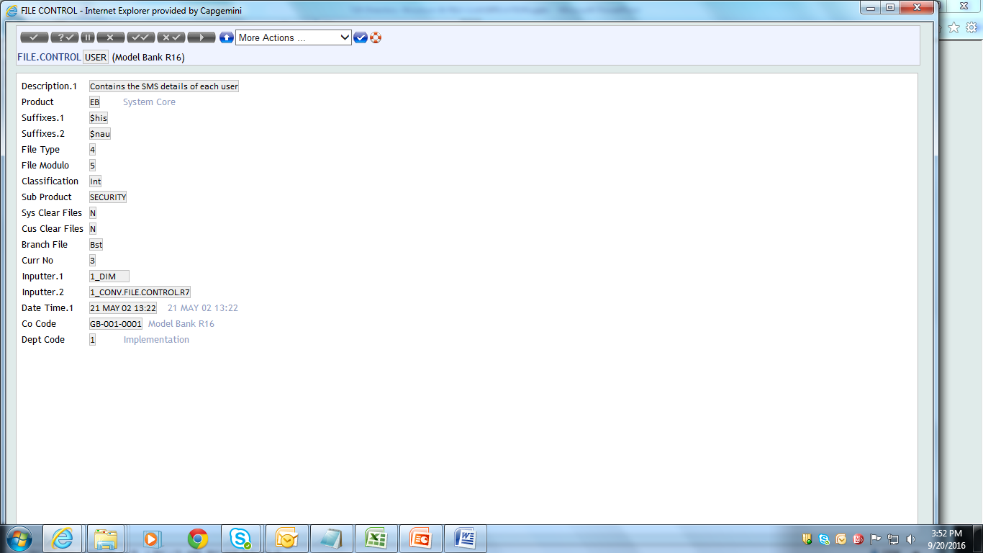
INT
INT Files are Installation files.
Eg: USER, CURRENCY, etc.
These files are common to all the branches
Only one copy of the file is maintained
Set up mostly during installation

Slide 16
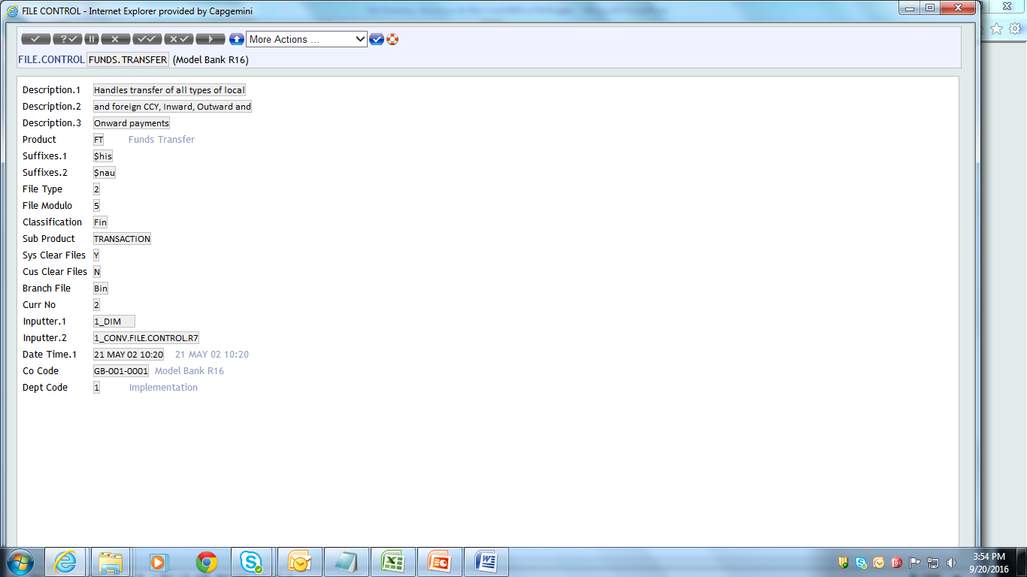
FIN
Financial Files
Eg: FUNDS.TRANSFER, BASIC.INTEREST, GROUP.DEBIT.INTEREST, etc.
Mostly maintained in the respective branches
Cannot be shared by other files.

Slide 17
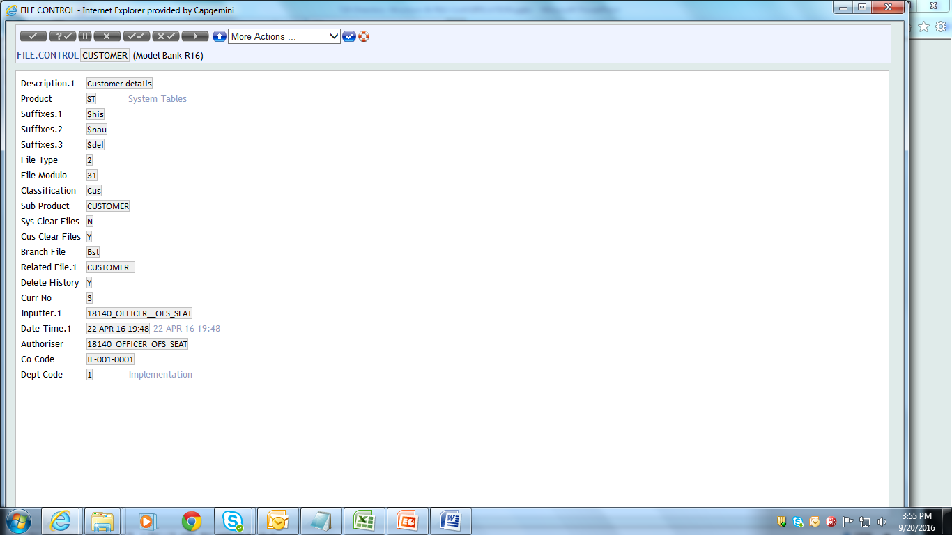
CUS
These files are also maintained in the respective branches
Eg: CUSTOMER, SECTOR, TARGET, INDUSTRY, etc.
Copies are maintained separately
But the data could be shared by all the branches

Slide 18
Core Parameter Files in T24
Some of the files and tables that constitute an important part in T24.
PGM.FILE
FILE.CONTROL
STANDARD.SELECTION
DATES
HOLIDAY
COMPANY
SPF

Slide 19
PGM.FILE
PGM.FILE stands for “Program File”. This is the application that keeps
track of all applications (programs) in T24.
For any application to be executed within the T24 environment
(command line), a valid entry should exist in PGM.FILE.
It is also checked to obtain the characteristics of the application.

Slide 20
PGM.FILE TYPES
H – A program that has this type maintains three files the unauthorised, live and history files. The unauthorised file is updated at input, the live file at authorisation, and the history file whenever there is an authorised change to a record.
U - A program similar to type ‘H’ except that history is not maintained.
L – A program that displays the data of a live file but does not allow updates. Updates to these files would be controlled by the system automatically.
T – A program that displays data in a table file(such as a list of keys) but does not allow update.
W – A program that permits updates to a work or temporary file. A typical example would be the REPGEN.OUTPUT program where print or display parameters for a report can be loaded.
B – A batch job that can only be accessed during the ‘off-line’ processing in BATCH.CONTROL
M – Main-line program that can be run from the action line but has nofile directly associated with it.

Slide 21
PGM.FILE TYPES – CONTD.
S – Subroutine. A program used in the T24 system but one that is executed automatically whenever required. It cannot be entered by the user either at the action line or from within the Batch Control System. It is recommended that these are loaded only when they are needed by the report generator.
Eg: IN2…routines.

Slide 22
FILE.CONTROL
To execute any application in T24, in addition to having an entry in the PGM.FILE, an entry for that particular application should exist in the F.FILE.CONTROL application.
FILE.CONTROL name denotes, controls the type of information being stored
in a file(application).
Only applications that store data will have an entry in the FILE.CONTROL application.

Slide 23
STANDARD SELECTION
All the application will have a data file and a dictionary file. The data file will store all the data’s of the application where as the dictionary file will store all the field names and their definitions.
Standard Selection will contain the field definition of all the fields in the application.
Standard.Selection contains only one record per application.
The Standard.Selection application not only contains the field definition of the fields (system fields), but also the definition of all local reference fields (user defined fields).

Slide 24
DATES
DATES is a very important application in T24.It is of type INT and hence only one copy of the file will exist irrespective of the number of branches that a bank may have.
As the name denotes, the DATES application is used to store the date of T24.
It is vital to understand that T24 maintains its own date and does not go by the system date.
ID : Company code(everybranch(company) will have a company code in T24 to uniquely identify itself. This is defined in the company file.
Example: ID:GB0010001

Slide 25
COMPANY
The Company file, as the name denotes contains the details of the various companies (branches) of a bank.
Only one record per company.
ID : Company Code
ID : IN0010001
Company record will also contain information like what are all the applications that are attached to this Company.
The auto id generation in each application are also specified in this Company application only.

Slide 26
HOLIDAY
The purpose of this table is to indicate the public hoildays for each country or Region within a Country, for the calender years over which the bank’s current business is spread.
The non-working weekend days are then generated automatically for the year and for this reason they do not have to be specified individually as public holidays.
Each GLOBUS application will refer to this table during input validation to verify that any dates entered by the user are working days or to force an override to accept non-working days.
The id of Holiday should be of this format. The US001998.
US – Country Code
00 – Region Code (default)
1998 – Year.
Region code should be defined along with Country Code in Region table, if region code has to be entered.

Slide 27
SYSTEM.PARAMETER.FILE (SPF)
SPF stands for ‘SYSTEM PARAMETER FILE’.
This file, is one of the first file which has to be setup during installation.
This file holds the details of the system wide parameters that are required to run the system.
This file will contain only one record and the ID of the record is ‘SYSTEM’.
This file contains all major information like license and all the products attached to the client and so on.

Slide 28


www.capgemini.com/financialservices

